Slide 1


Windows 10 End of Support
So – NOW WHAT?

Slide 2
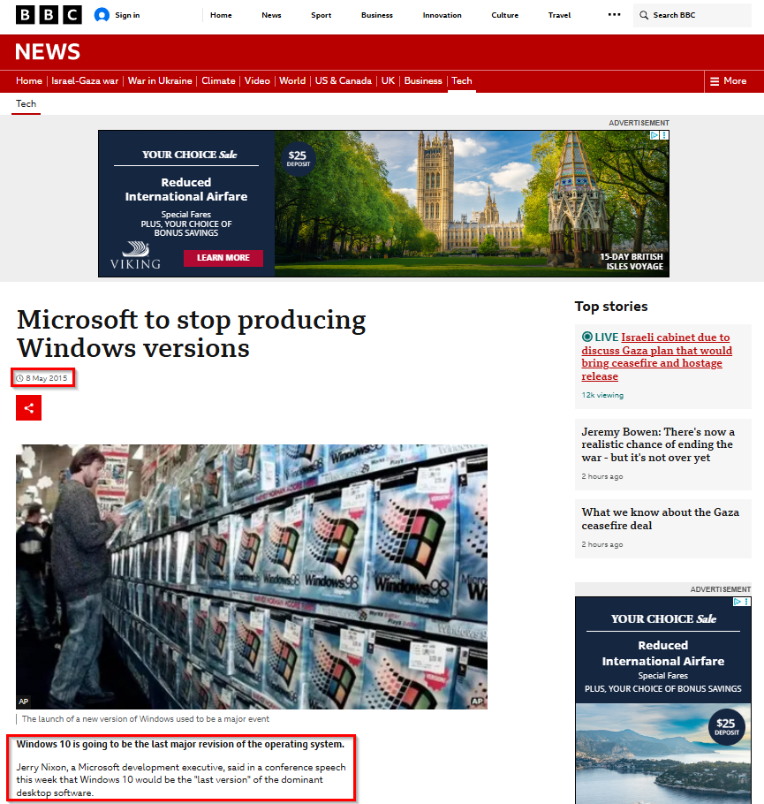

Slide 3
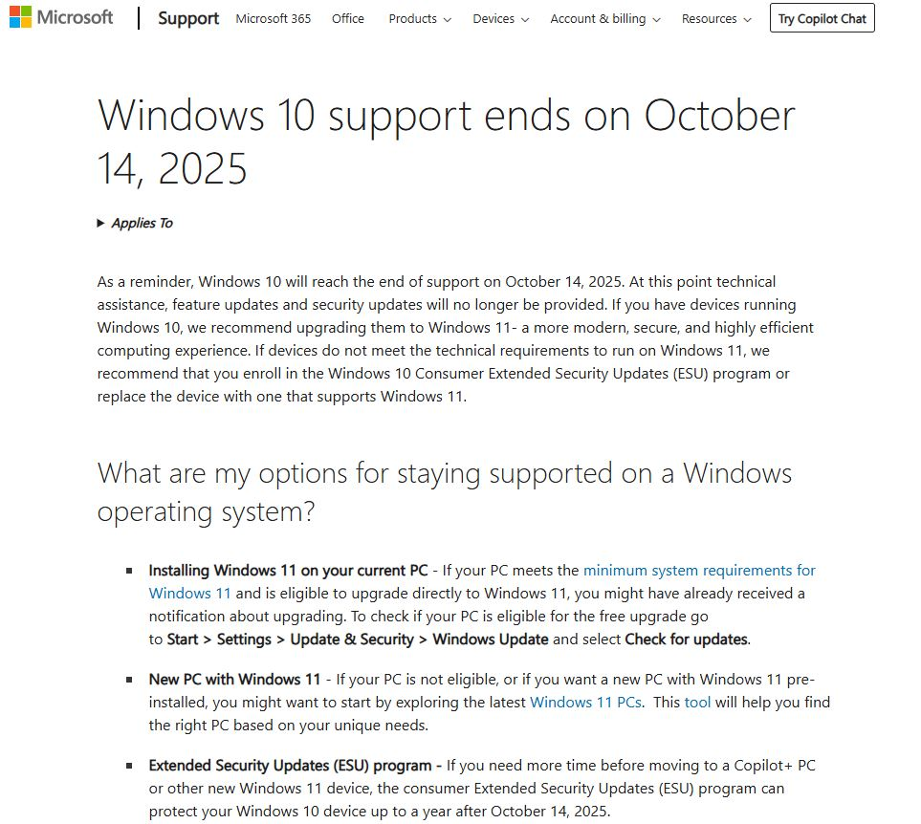

Slide 4
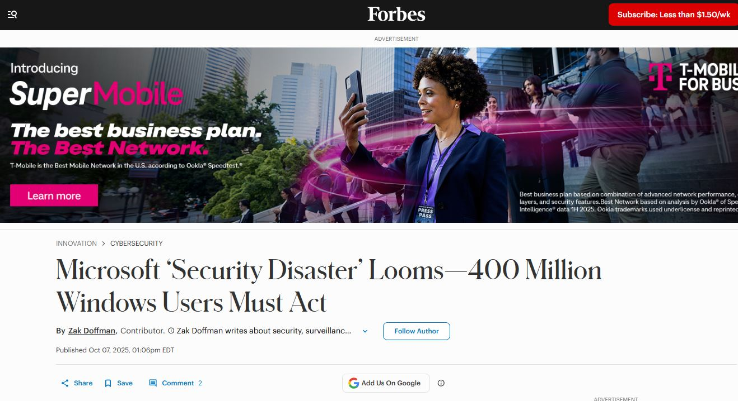

Slide 5
Microsoft Windows is now a Service
YOU are the product!
Microsoft makes revenue from the targeted advertising aimed at you...
AND selling the information gathered from you to information brokers and other advertisers
Similar to the Google model

Slide 6
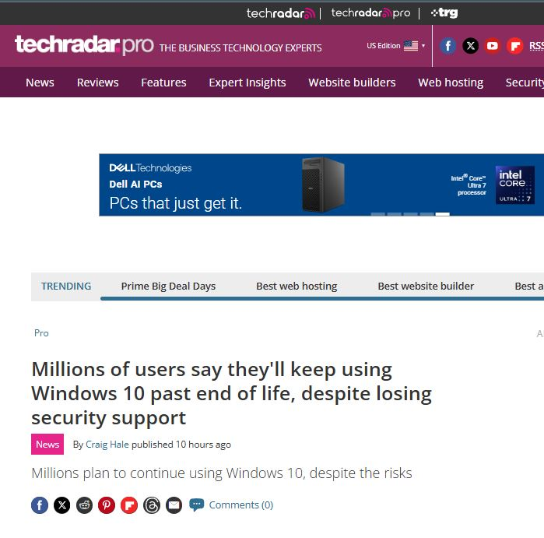

Slide 7
What’s going to happen on October 14 – if I do nothing?
Your Windows 10 computer will keep working
You will NO longer receive any updates from Microsoft, not even security updates
This means your machine will become more susceptible to viruses and exploits over time
Some applications may eventually stop working (if that software vendor decides to de-support Windows 10)

Slide 8
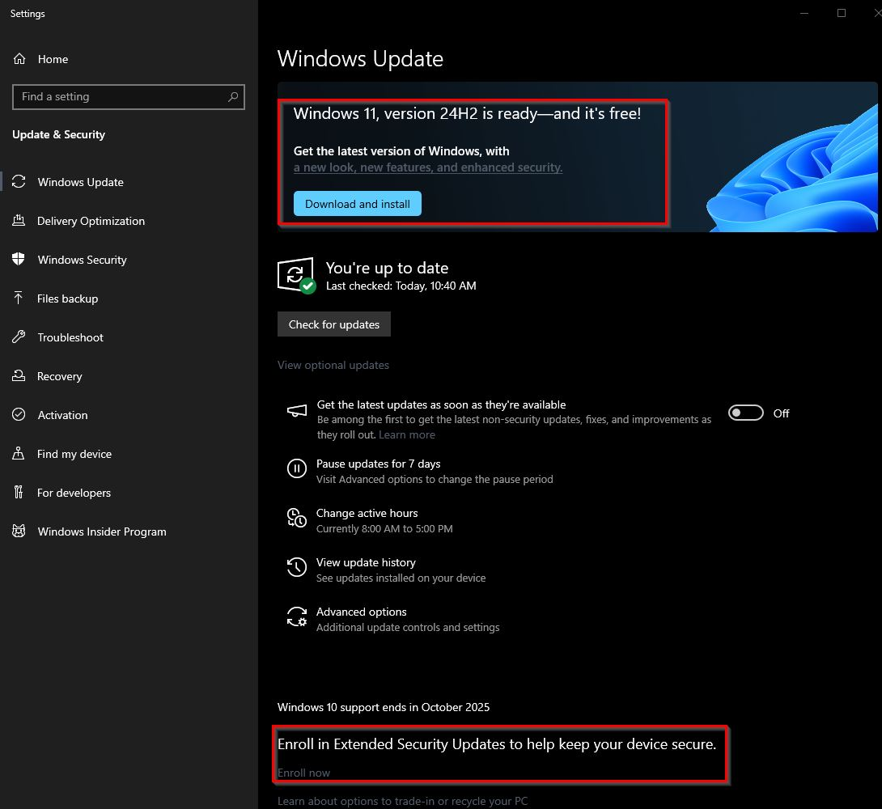

Slide 9
IF you are sticking with Windows 10 – GET Extended Updates!
Easy to register to receive Extended Security Updates
FREE! (with a catch)
Will get only Security updates until October 14, 2026. Gives you a year to plan to do something else.
WHAT’S THE CATCH?
You MUST register with a Microsoft Account. This will backup settings from your computer (and also allows Microsoft to collect telemetry tied to you)
You can switch to a “local” account after registration, but Microsoft will still be tracking you

Slide 10
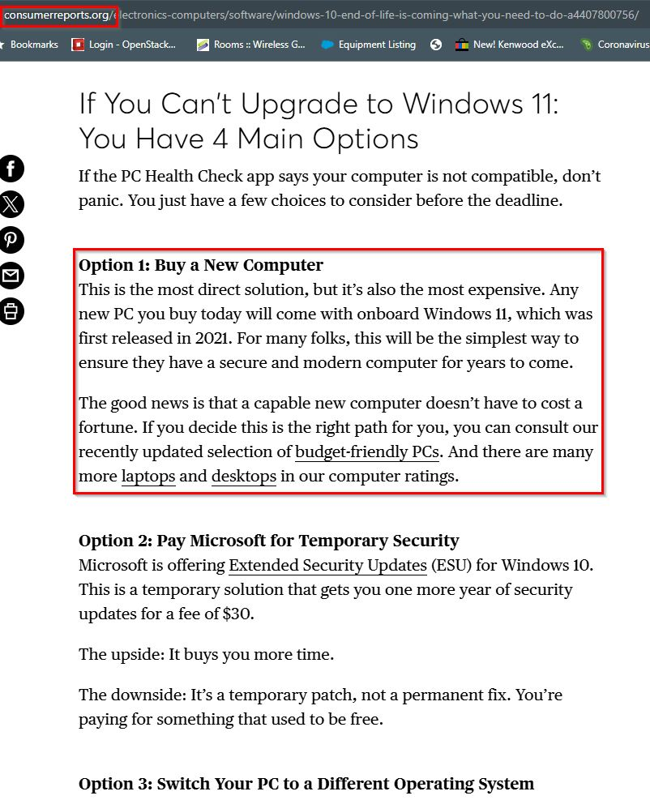

Slide 11
BUY A NEW COMPUTER!!!
This is what Microsoft – and their hardware partners (Dell, Lenovo, HP, etc) REALLY want you to do. This is the reason Microsoft set the hardware requirements for Windows 11:
  TPM 2.0 (Trusted Platform Module), hardware-based security. Needed for Windows Hello (biometrics) and Bitlocker (whole disk encryption)
  8th generation Intel or similar era AMD CPU (roughly circa 2019)
This requirement is going to cause a LOT of e-waste, and a lot of consumers (in this economy) cannot afford to just go out and buy a new computer.

Slide 12
NEW Computer – budget?
Laptops: about $500 for a decent entry-level machine
Desktops: again, about $500 for entry level. Maybe a bit less.
For a desktop, if your monitor, keyboard, mouse, and printer are in good condition you can continue to use them – and just replace the base computer.
I highly recommend getting 16GB of RAM and a 500GB NVMe solid state storage as a minimum
Purchase the fastest/most cores CPU you can afford

Slide 13
Lower cost alternatives!
Companies are refreshing their desktop and laptop fleets
Used or reconditioned laptop or desktop can provide a good machine at a great price
CAVEAT EMPTOR! Some of the “Windows 11” machines on eBay have non-certified CPUs... If you want a Certified platform, remember to get 8th generation Intel (or newer) and TPM 2.0

Slide 14
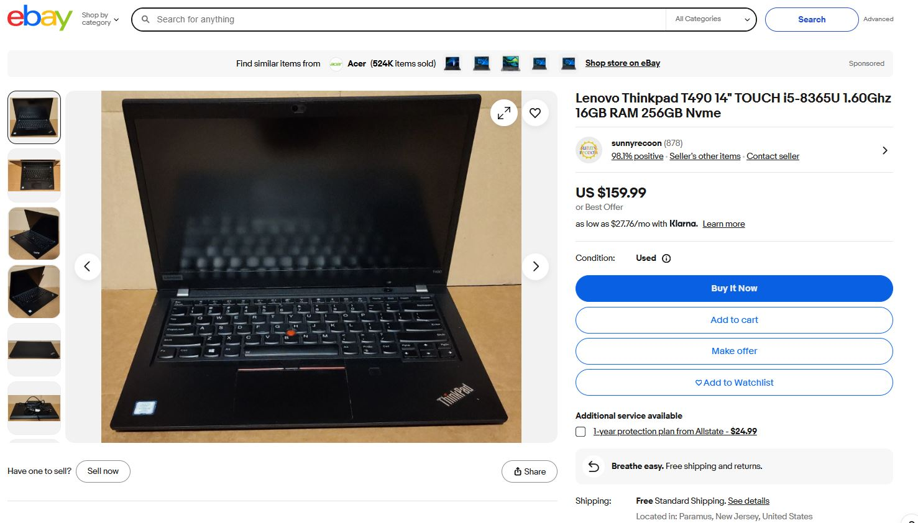

Slide 15
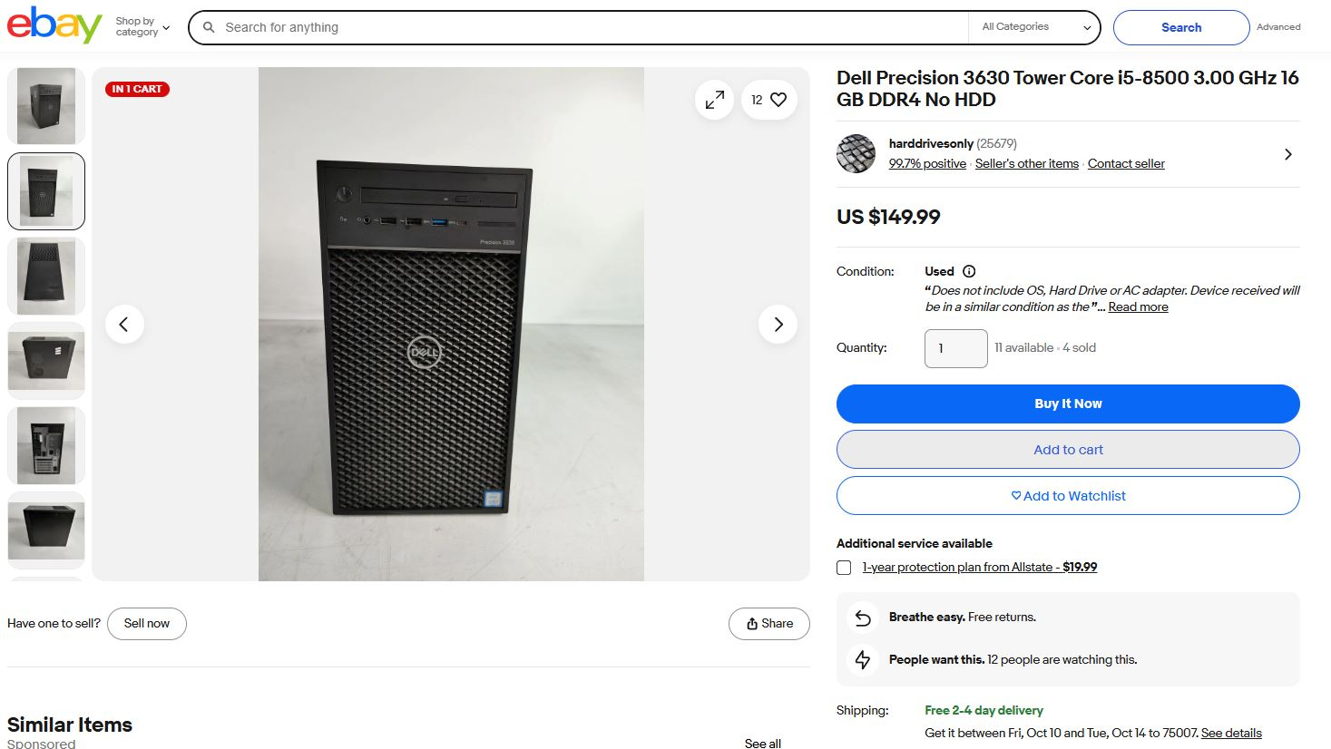

Slide 16
Budget busters!
Consider a non-certified config
4th, 5th, 6th, and 7th generation Intel CPUs can run Windows 11 just fine (my “ham” laptop has a 6th generation and is running Windows 11 quite happily)
TPM 2.0 is for Biometrics and Bitlocker, probably not important for a consumer
I will show you ways to install Windows 11 on non-certified hardware...

Slide 17
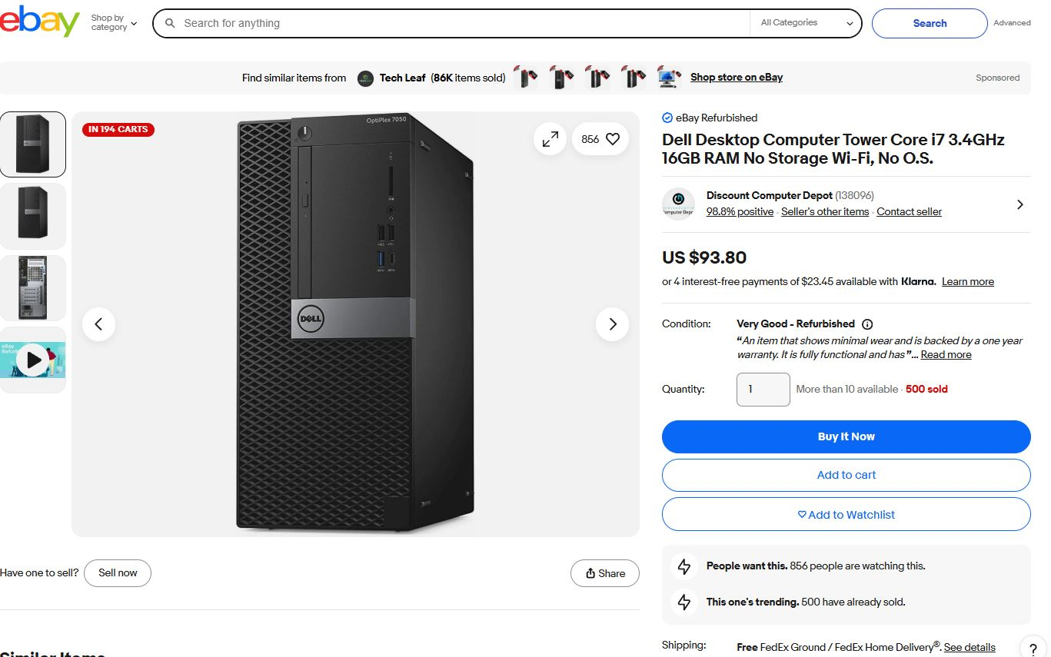

Slide 18
My suggestions:
If you purchase a used laptop or desktop, plan and budget to REPLACE the hard drive, SSD, or NVMe.
The single upgrade you can do that drastically improves performance is replacing a hard drive with an SSD. Upgrading to an NVMe (if possible) provides even more performance.
SSD and NVMe devices have a long, but limited, life. Prices are VERY reasonable today. It’s also safer to install an OS on factory-fresh storage media.
500GB NVMe from Microcenter: $39.99, 1TB $64.99
512GB SSD from Microcenter $35.99, 1TB $64.99

Slide 19
Upgrade to Windows 11
On existing hardware

Slide 20
IF your machine is compatible with Windows 11?
You can use that link in Windows Update to download and upgrade your OS
I HIGHLY, STRONGLY encourage you to BACK UP YOUR MACHINE FIRST! I have more information on backup coming up soon.
If you need more time to do a proper backup, consider just registering for Extended Updates now.

Slide 21
IF your machine is NOT compatible with Windows 11?
You can still upgrade to Windows 11! I’ll show you how.
I HIGHLY, STRONGLY encourage you to BACK UP YOUR MACHINE FIRST! I have more information on backup coming up soon.
The tools that I show you are free and will override the TPM 2.0 and CPU requirements.
This method is NOT SUPPORTED by Microsoft. It works, and Microsoft has a history of “looking the other way”... But they could decide to ship a patch that will stop an incompatible machine from getting future patches.
The community has a track record of issuing workarounds for things that Microsoft does

Slide 22


BACKUP!
Get a full backup before upgrading!
If you don’t have a backup utility, I suggest using EaseUS Todo Backup Free. It is FREE and easy to use. The easiest backup target could be an external USB hard drive or big USB stick.
EaseUS Todo Backup - Best Free Backup Software for Windows 11/10/8/7
X out this window
Click this

Slide 23
EaseUS Todo Backup Free tutorial
Ask Leo! YouTube channel
https://youtu.be/g5lHcCdIO6U?si=aDyXqZOFywZdvn69

Slide 24
Upgrade HDD with SSD or NVMe?
If you purchase a Samsung or Western Digital SSD or NVMe, those vendors have free utilities available to download to help with the migration (Samsung Magician; Western Digital – Acronis True Image)
Otherwise, use Disk Genius (FREE)
Download the Free version here:
https://www.diskgenius.com/editions.php
Tutorial – on OnlineComputerTips YouTube channel!
https://youtu.be/0q4ryWrAWSQ?si=ONb2PDV5bPdOzMJK

Slide 25
FRESH INSTALL vs UPGRADE IN PLACE
You can upgrade from Windows 10 to Windows 11 in place – saves files, folder, and apps
It works well (most of the time)... That’s why you need a backup.
Fresh Install allows you to “clean house”, freshen things up. Get rid of junk. You can bring data (Documents folder) back from an image or folder backup, and you can fresh install just the apps that you need/want.

Slide 26
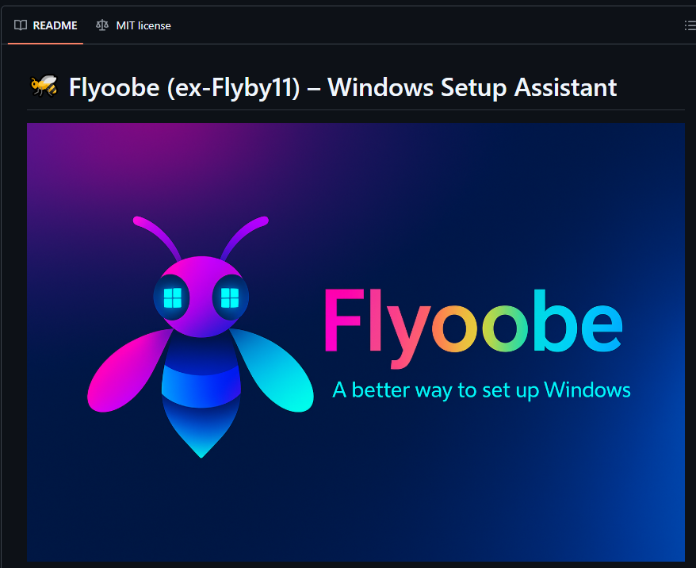
New, recommended tool:
Flyoobe

Slide 27
Flyoobe features
Windows 10 to 11 upgrades
Allows for upgrade-in-place (save files) or fresh install
Bypasses the TPM, Secure boot, and CPU hardware checks
Also has a post-installation tweak and “debloat” utility
FREE and open-source
https://github.com/builtbybel/Flyoobe

Slide 28
Flyoobe
Tutorials
B Is For Budget YouTube Channel
https://youtu.be/0ltt7p75N9M?si=yQBF9Yj8EPbAibZC
OnlineComputerTips YouTube Channel
https://youtu.be/SLMwTsOhw9c?si=96w5y2LC93pCevd_

Slide 29
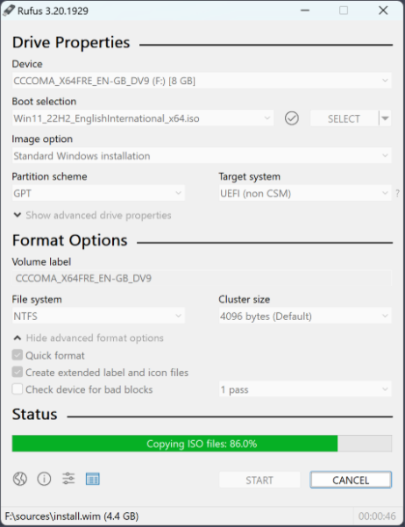
Alternate tool for installs:
Rufus
Rufus is a free and open-source tool to easily create bootable USB drives https://rufus.ie/en/
Current versions of Rufus contain a feature that will configure a Windows 11 bootable USB drive with the hardware bypass workarounds
Tutorial: Install Windows 11 on unsupported hardware using Rufus
https://youtu.be/J5mDUU9GCNo?si=vQ5pK2LDeIuRSNiG

Slide 30
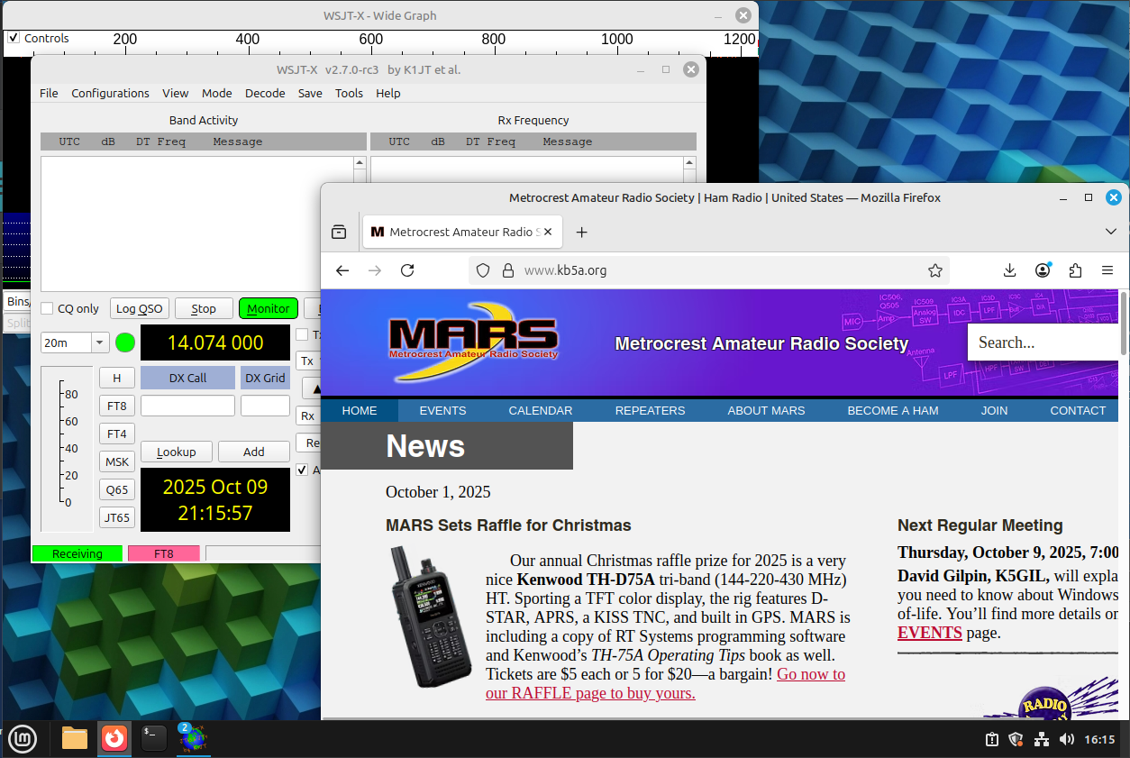
Another choice:
Switch to Linux or Mac
Linux is FREE to download and use
No company looking over your shoulder
Surf the net, do email, word processing, presentations = free software
SOME ham radio software is compatible with Linux and Mac (FLDIGI, WSJT-X)
Big exceptions: Ham Radio Deluxe, N1MM, FlexRadio SmartSDR
There is a special version of SmartSDR for MAC now available ($99.99)
Linux Mint Cinnamon is a popular Windows alternative

Slide 31

Thank You!
dggtx1@gmail.com

